Slide 3
Butler Tutoring Lab
cade was here

Slide 4
Sharpen your skills at the tutoring lab today!
cade was here

Slide 5



Follow us on Twitter, Instagram and Facebook!!!
@butler_tutoring

Slide 6
Quality is not an act, it is a habit

Slide 7
WE want to help you today!!!

Slide 8

Study tips!!!
Pick a place and time. Everyone has their own idea about the best place and time to study.
Study every day.
Plan your time.
Discover your learning style.
Review and revise.
Take breaks.
Ask for help.
Stay motivated.

Slide 9
Mariam Alky
I am a 17-year-old high school student. For 4 years, I lived in Belgium and I studied in both an international setting and a local setting. I speak 3 1/2 languages; English, Arabic, Dutch, and French (1/2). I love writing and reading. I also enjoy learning new ways to apply my knowledge to more complex problems. I am currently a tutor ambassador at Butler and I tutor Algebra and Anatomy and physiology online.

Slide 10
Fabiola Ayarza Anorga
Hello! I'm Fabiola Ayarza. All my friends call me Fabi. I'm 29 years old and from Lima City - Peru (South America). My major is in Human Resources Management. I studied English as a second language at WSU -Intensive English Language Center . Actually, I'm a tutor in Spanish at Butler in Andover 6000 building. My hobbies are run every morning , dance, listening music , I love to travel!, and have good time with my family and friends. If you need any help with any another class like Public Speaking, Art Appreciation , Info processing system, Fundamental of Management. I'll be glad to help you!

Slide 11
Kelly Brown
I am originally from Wichita, Ks. I have recently moved back to Kansas to be closer to family after my husband finished his Chiropratic program in Texas. We have 2 Labrador Retrievers , 1 Great Dane puppy, and two cats. I am the second to last child out of seven children. Most of my family lives in Wichita, Ks.

Slide 12
Asher Cole
Hey, I'm Asher. I'm 18 and pursuing a degree in Pre-Engineering. I hope to then go on and receive a Mechanical Engineering degree from K-State. While I'm not in class, I can be found outdoors or at Butler In the tutor lab.

Slide 13
Mark McNemee
I had taught high school mathematics along with coaching basketball and football for 19 years before joining the Butler Family. I truly enjoy the excitement in a student's eyes and voice when they are able to understand Algebra and see that there wasn't as much to fear as they thought. When I am not teaching math, I enjoy watching any sports team that resides in Missouri, especially the MU Tigers. Although, if you can't find me on campus (or the virtual lab) and there isn't a game on tv, then you will find me on the golf course.

Slide 14
Kaylie Hansen
Hi! I'm Kaylie. I'm 19, and I'm majoring in pre-health because I've wanted to be a doctor since I was little. I'm really passionate about science and math, because they make a lot of logical sense to me. I have two pet rabbits, and when not studying, I'm usually trying to get them to not chew on every cord in my house. Nice to meet you!

Slide 15
Madison Jennings
Hello! My name is Maddie, and I am a second-year sophomore and well-rounded English Tutor at the Butler of El Dorado Tutoring Lab . You can also find me at your local Wichita East Menards, where I help our guests save big money as a Front-End Supervisor.

Slide 16
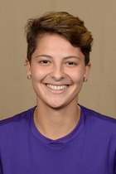
Maria Julia Manasses Valaski
Hey Everyone,
My name is Maria Julia, but I go by Maju! I'm from Brazil and during my last semester at Butler I'm having the opportunity to work from my home city. I'm a math tutor who really enjoy helping students who want to learn and not just memorize everything :)
I'm on the Zoom meeting every Tuesday, Wednesday and Thursday from 12pm to 4pm and on Friday from 12pm to 3pm.

Slide 17
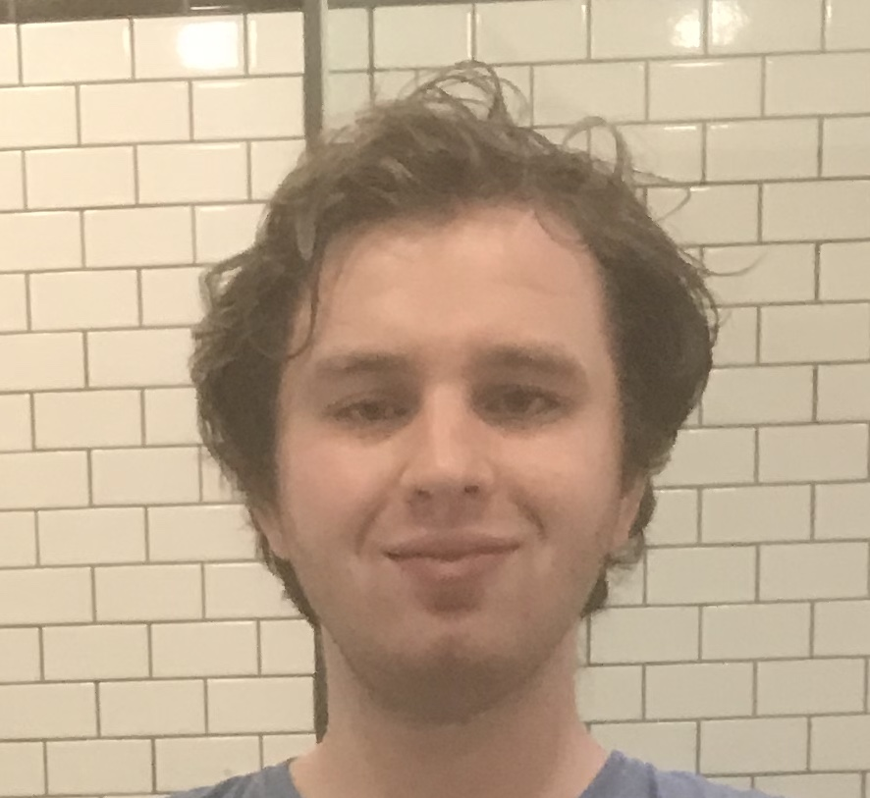
Alex Dyer Owens
+22 years old, aspiring history teacher attending Butler for a associates in secondary education.
+Enjoys reading, running, and painting.
+Self proclaimed history buff..

Slide 18
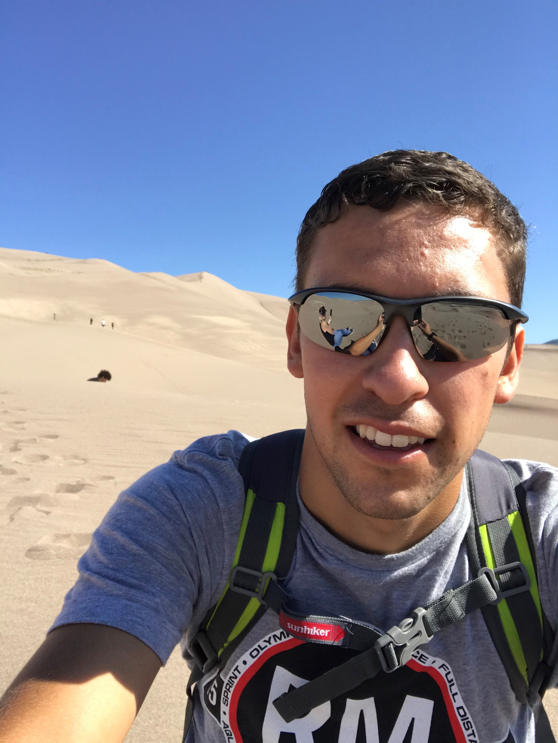
Octavio Pacheco Vazquez
Hello! My name is Octavio Pacheco. I am 22 years old and I am currently working towards a Bachelor’s in physics. My biggest goal in life is to work for NASA, SpaceX or any space agency. If possible, I would love to get into a space program. My hobbies are exercising, eating, being outside, and studying. You can find me as a tutor in the Andover campus on Tuesday and Thursday, I will be more than glad to help you out with math, chem, and even Spanish (I am a native speaker).

Slide 19
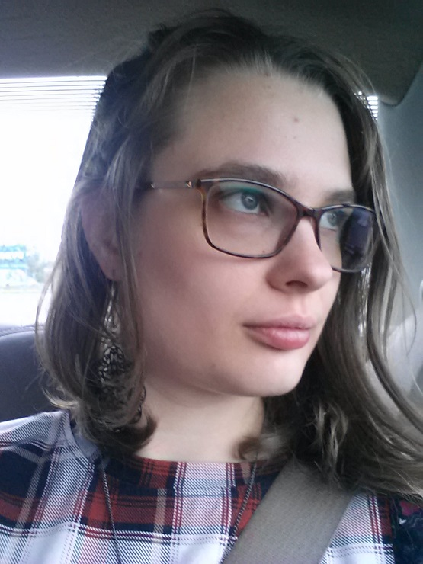
Sarah Penick
Hi, there! My name is Sarah, and I am a non-traditional student with a minor disability. I am majoring in Psychology because I plan to become a Marriage and Family Therapist. My last name is pronounced "PEA-nick" ("pea" as in the little green vegetable), and I appreciate it when my name is said correctly! When I'm not in class, you can find me on campus in the Tutoring Labs. We would love to help you if you get stuck -- please feel free to stop by! I am a cat mom, and I love to write, read, crochet, and draw (among other things) when I'm not working or studying.

Slide 20
Trinh Pham (Jenny)
Hi, my name is Trinh Pham, but I would like to go by Jenny. I am currently majoring in Pre-nursing at Butler. I am also a tutor in Anatomy and Physiology, College Algebra, and general Biology, so if you need help in any of those subjects, you can find me in the lab tutor on the Andover campus. My hobby is watching movies, especially romantic & comedic ones. Sometimes, I like to drive around when the weather is nice and grab some drinks to enjoy my free time.

Slide 21
Red Green
Hello! My name is Jordan, but everyone knows me as Red. I am 25 years old and currently pursuing a double major in zoo science and conservation. I hope to use this education to help conserve natural and historical habitat, as well as preserve the wildlife that has become endangered through human involvement. While not in class, I can either be found bartending at Outback Steakhouse or working at Butler as an assistant to the head of the tutoring labs. Come visit!

Slide 22
Betty Taylor

Slide 23
Jason Wibowo
I am a 17-year-old Early College Academy Engineering Technology student pursuing a degree in electrical engineering. In my spare time, I enjoy programming and learning new things.

Slide 24
Isabella Winter Cocchi
Hello! My name is Isabella but I usually go by Bella. I am majoring in Pre-Engineering at Butler, I'm still a little indecisive on what kind but my first choice at the moment is Product and Manufacturing Engineering. My main goal is to make an impact and hopefully improve some concepts in that career field. I am currently a Tutor Ambassador at the El Dorado math lab.

Slide 25
Barbra Derstien

Slide 26
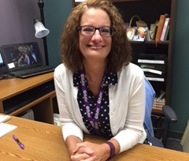
Cindy Bond
My name is Cindy Bond. I have been teaching algebra classes at Butler since 1995. I enjoy seeing my students find confidence in learning math concepts! I am married and have two grown children. I also have a mini-poodle named Baxter! Outside of Butler, I enjoy spending time with family, being involved at my church, and reading a good book!

Slide 27
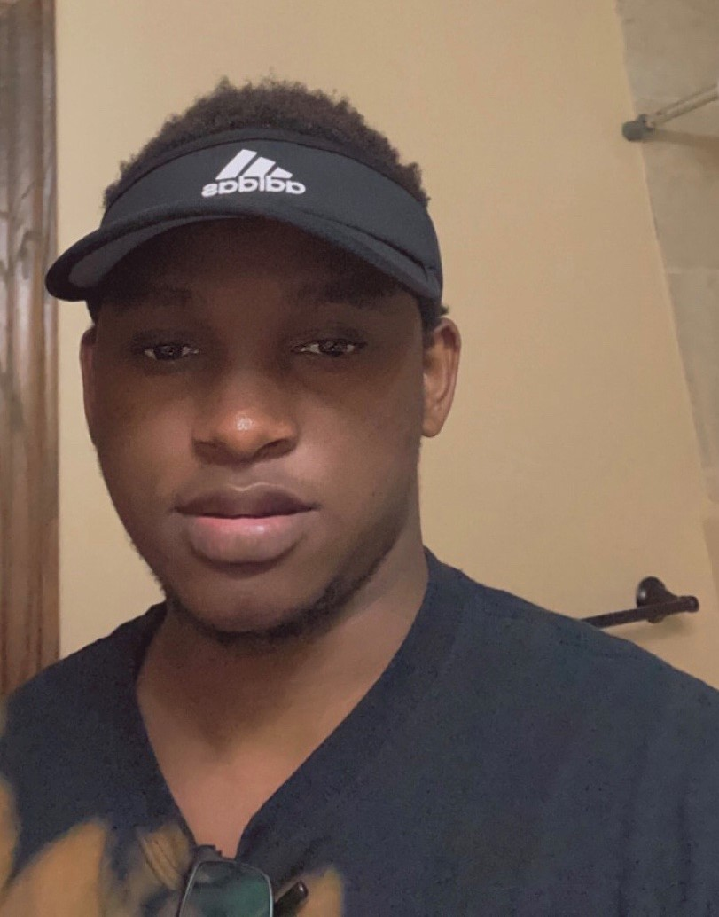
Raphael Mfuko
Hi!, my name is Raphael. I’m an international student from Tanzania and my major is pre-med. If you need help with math( all the way to calculus) then I’m your guy, but I also do chemistry 1 too.

Slide 28
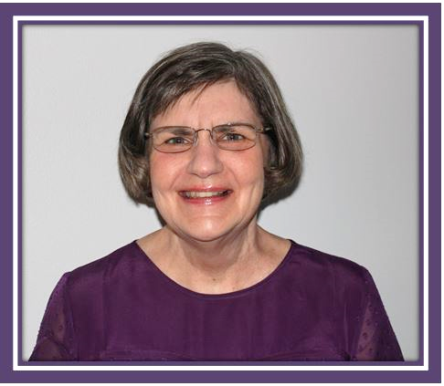
Vicky Raunch
I've been teaching since "the earth cooled". My husband also teaches, and together, we've been doing it for 80+ years! Math is my specialty, and I believe anyone can learn this dreaded subject if taught correctly.

Slide 29
Katelin Miller-Vanatta
Hi, my name is Katelin but you can call me Kate or Katie, whichever works. I'm 20 years old and double majoring in Computer Science and Civil Engineering! I have a love and appreciation for math and science as well as creative thinking and technology. I hope to someday improve our structural designs and our engineering/CAD software for the future. When I am not class, you might see me on the El Dorado campus as a student worker helping both teachers and students, or you'll meet in our virtual tutoring center. Also, if you're ever struggling in a math class, drop by the virtual math and I can help among other tutors and teachers as well. Until then, see you later!

Slide 30
Debora Nelson

Slide 31
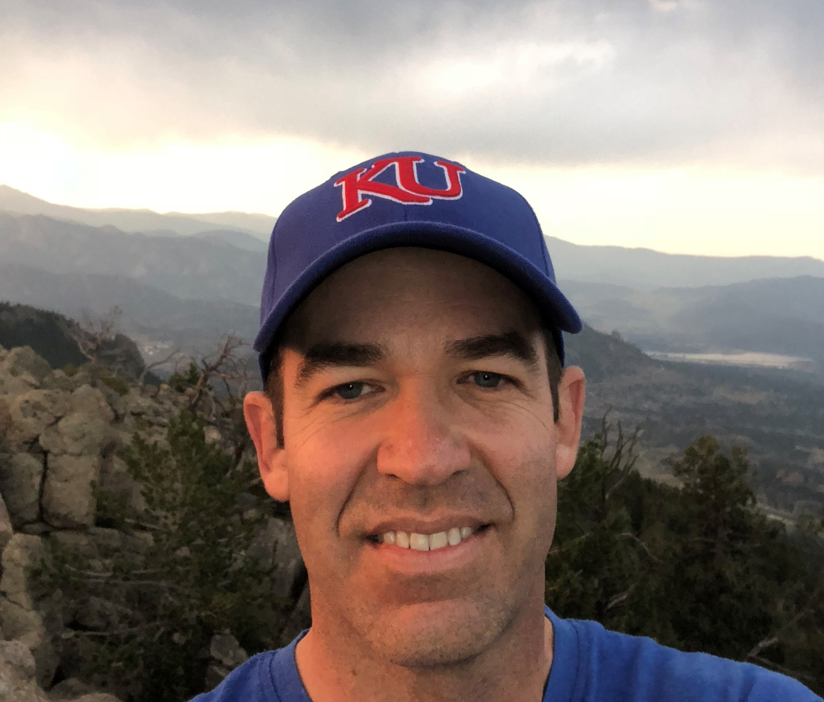
Scott Dwyer
This is my eleventh-year teaching at Butler Community College as an adjunct math instructor. I have a Bachelor of Science in Business Administration degree from the University of Kansas.
I have a passion for teaching, and I believe in learning by doing. Mathematics is a challenging subject for many people. It is important to learn and understand key concepts through practice. Material builds upon itself as you progress through your math courses.
By understanding the material and simply not "memorizing" it, you will have a better chance of retaining and using the material when you need it again.
I am an avid golfer. I was an assistant golf professional for two years but found that I enjoy playing the sport much more than pursuing a career in it. I also have a passion for listening to music, watching sports especially NFL football, college basketball and golf, and playing cards. In addition to teaching, I own a small business that I operate out of my home.

Slide 32
Bradley K. Miller
Received his Master’s degree from Emporia State University and has been teaching for Butler Community College for twenty years. Skilled in English Comp one and two, Fundamentals of English, American literature, Irish literature, African-American literature, and various research techniques.

Slide 33
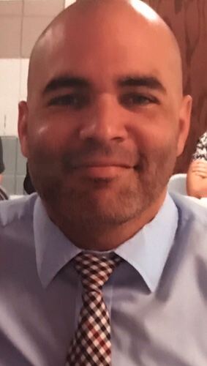
David Jones
My name is David Jones.
I am originally from Arkansas City, KS (about an hour south of Wichita) and am a graduate of Emporia State University with a degree in Math Education. I have been teaching at the college level since 2008, and really enjoy it. In my free time I like to watch movies and sports (mainly the NBA and Tennis). I also enjoy playing basketball whenever I get the chance.

Slide 34
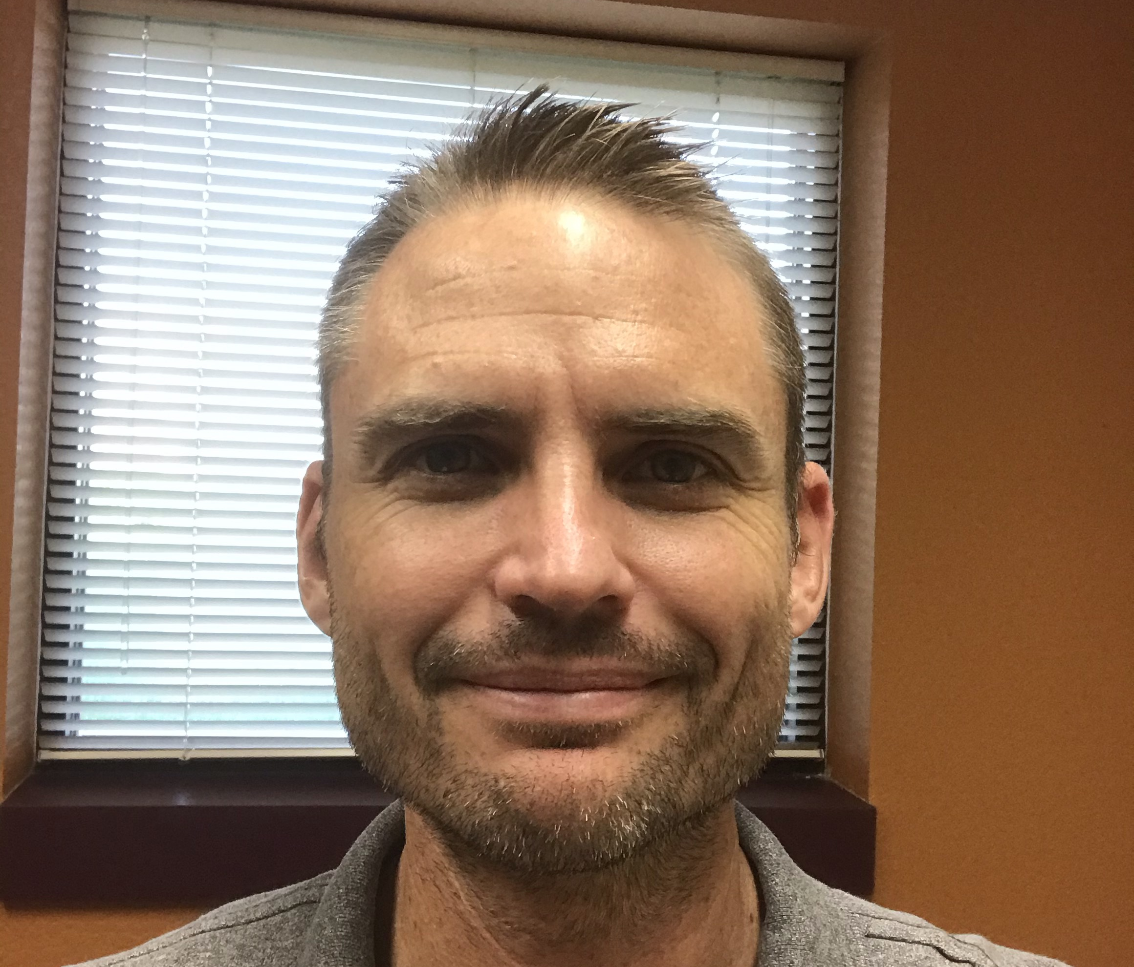
Benjamin F. Bunck
Professor Ben Bunck has been teaching Mathematics at Butler since 2007 and is currently one of the Lead Instructors in the Mathematics Department. He especially enjoys teaching Calculus and regularly teaches Calculus 1, 2, and 3. In his spare time, he enjoys running, cycling, and generally spending time outdoors.

